Slide 1
PROJECT -2
FINLATICS – ENABLING INSIGHTS
Presented BY - PRAVAL GUPTA

Slide 2
WINE quality data SET
QUESTIONS
What is the most frequently occurring wine quality? What is the highest number in and the lowest number in the quantity column?
How is `fixed acidity` correlated to the quality of the wine? How does the alcohol content affect the quality? How is the `free Sulphur dioxide` content correlated to the quality of the wine?
What is the average `residual sugar` for the best quality wine and the lowest quality wine in the dataset?
Does `volatile acidity` has an effect over the quality of the wine samples in the dataset?
Train a Decision Tree model and Random Forest Model separately to predict the Quality of the given samples of wine. Compare the Accuracy scores for both models.

Slide 3
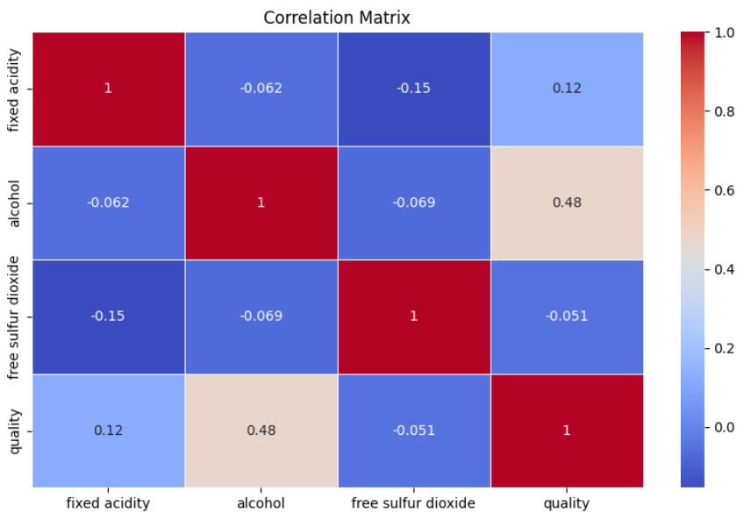
Q1. What is the most frequently occurring wine quality? What is the highest number in and the lowest number in the quantity column?
Most frequently occurring wine quality : 5 Highest number in the quality : 8
Lowest number in the quality : 3
Q2. How is `fixed acidity` correlated to the quality of the wine? How does the alcohol content affect the quality? How is the `free Sulphur dioxide` content correlated to the quality of the wine?
Interpretation and Conclusion :
As the value of the Correlation coefficient between the variables fixed acidity and quality is 0.12405164911322257, it represents a Weak Correlation which suggests a faint relationship in the positive direction that might not be practically significant.

Slide 4
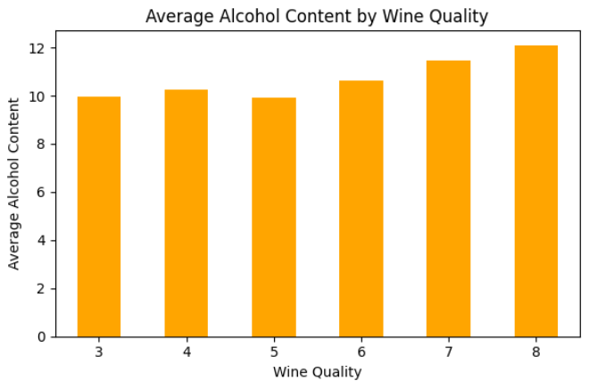
As the value of the Correlation coefficient between the variables free sulfur dioxide and quality is -0.05065605724427594, , it represents a Weak Correlation which suggests a faint relationship in the negative direction that might not be practically significant.
As the value of the Correlation coefficient between the variables alcohol and quality is 0.4761663239995377, it represents a Moderate Correlation which suggests a faint relationship in the positive direction that might not be practically significant.
Here, we can clearly see that as the alcohol content increases in the wine the quality is at it maximum value. for low alcohol content the quality also deteriorate. But, exceptionally at Quality Number 5, there is a dip in alcohol content.

Slide 5
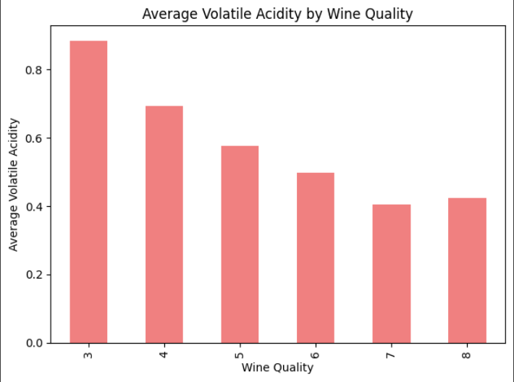
Q3. What is the average `residual sugar` for the best quality wine and the lowest quality wine in the dataset?
quality
3 2.635000
4 2.694340
5 2.528855
6 2.477194
7 2.720603
8 2.577778
Name: residual sugar
Conclusion:
For lowest quality wine, the Average residual sugar is : 2.6350000000000002
For highest quality wine, the Average residual sugar is : 2.5777777777777775
Q4. Does `volatile acidity` has an effect over the quality of the wine samples in the dataset?
Correlation Coefficient between volatile acidity and quality: -0.390557780264007
Interpretation and Conclusion :
As the value of the Correlation coefficient between the variables free sulfur dioxide and quality is -0.390557780264007, , it represents a Weak Correlation which suggests a faint relationship in the negative direction that might not be practically significant.
The conclusion is as the volatile acidity increases, wine quality tends to decrease and vice-versa.

Slide 6
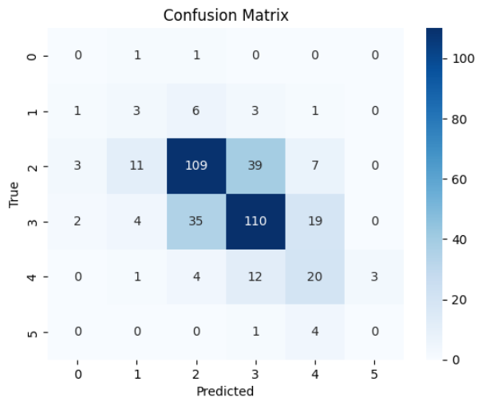
Q5. Train a Decision Tree model and Random Forest Model separately to predict the Quality of the given samples of wine. Compare the Accuracy scores for both models.
DECISION TREE MODEL
The model performs well on Quality 5 and Quality 6, with high correct predictions (109 and 110respectively).
Here is noticeable confusion between Quality 5 and Quality 6, suggesting similar features.
Quality 3, 4, and 8 are poorly classified, with almost no correct predictions.
The Accuracy score for the decision tree model is : 0.605 or 60.5%

Slide 7
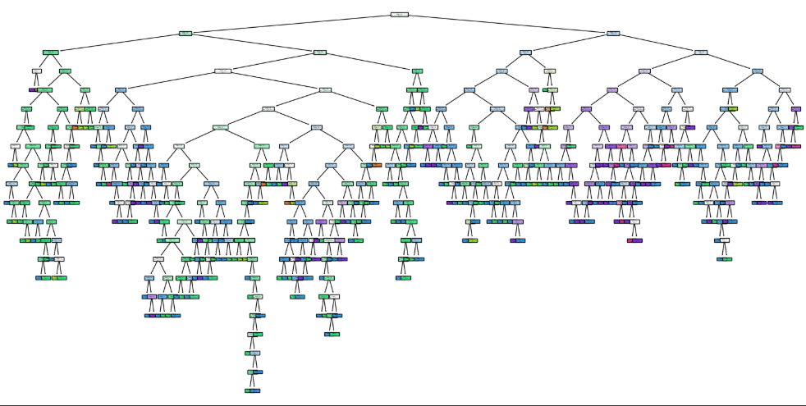
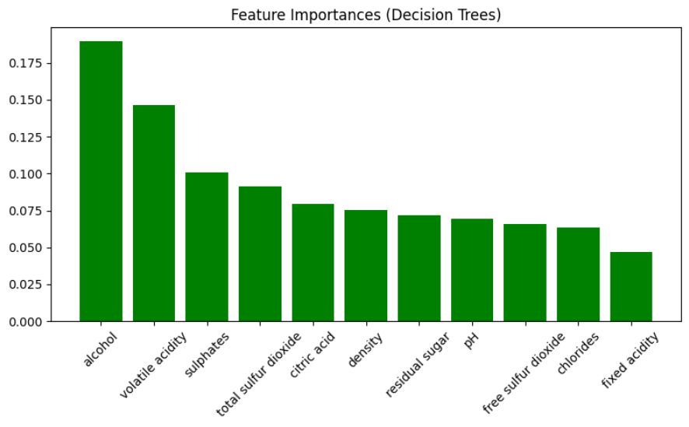
The Decision Tree Model
This graph shows the impact of the features on the quality.

Slide 8
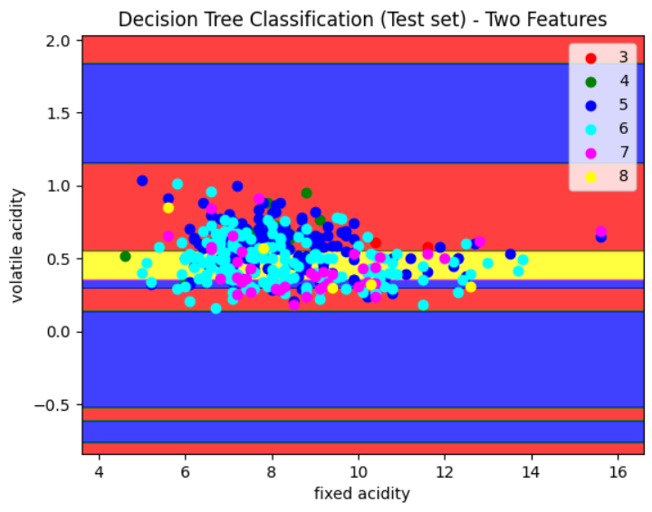
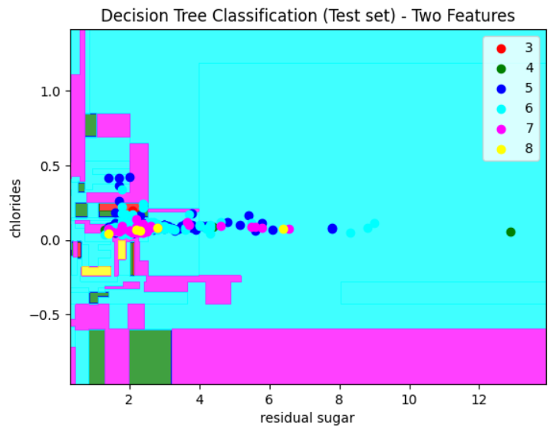
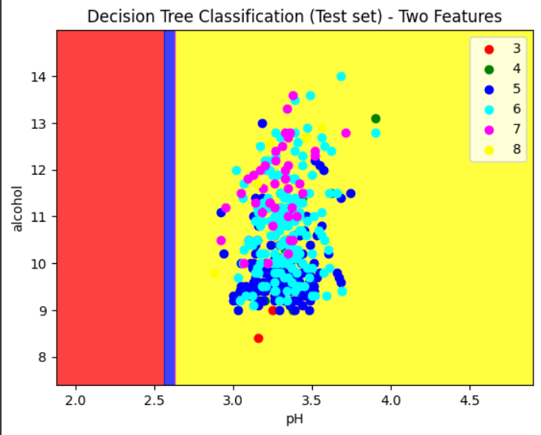
The Decision Tree Classification – Two Features

Slide 9
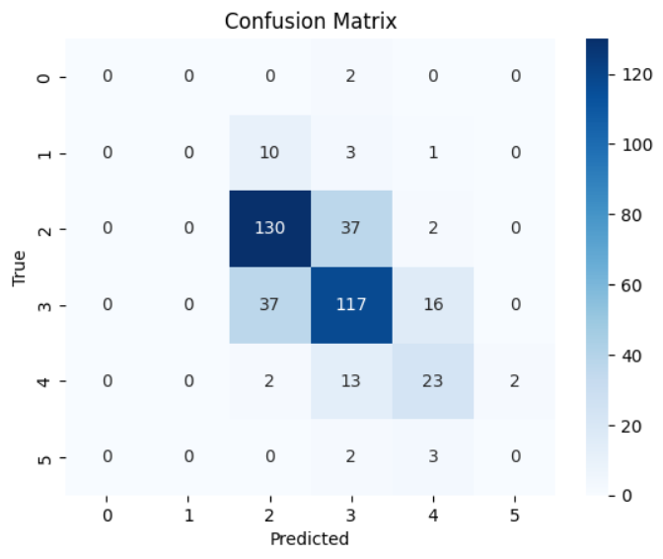
RANDOM FOREST MODEL
The model classifies Quality 5 and 6 accurately but shows confusion between them.
Quality 3, 4, and 8 have poor prediction due to low representation.
Misclassifications suggest overlapping features, especially between Quality 5, 6, and 7.
Overall, performance is good for major classes but needs improvement for minor ones.
The Accuracy score for the random forest model is : 0.675 or 67.5%
The Accuracy of the Random Forest Model is greater than the Decision Tree
Model shows that the Random Forest Model predicts more accurately than
the Decision Tree Model.

Slide 10
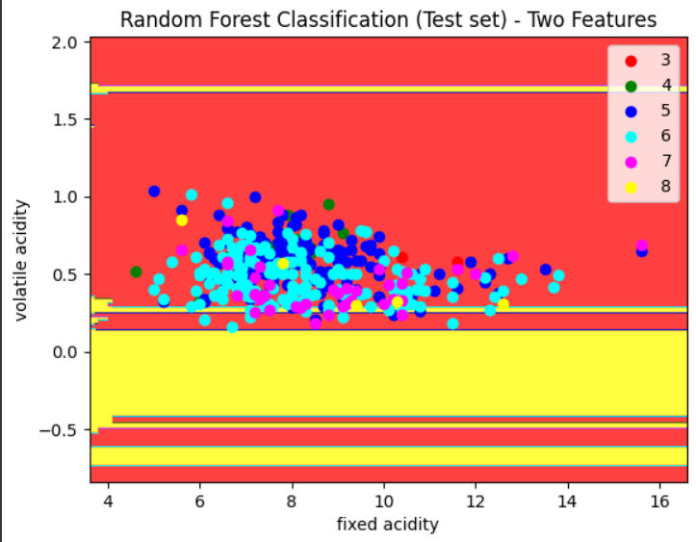
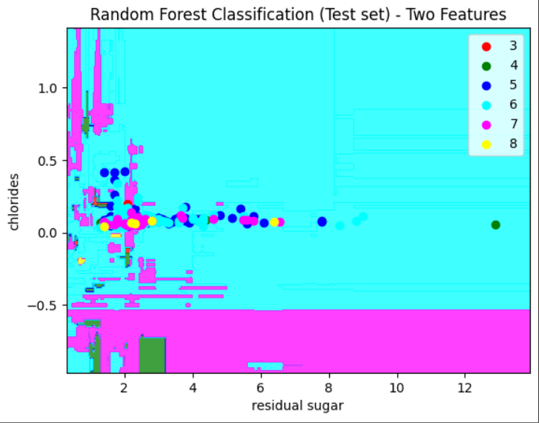
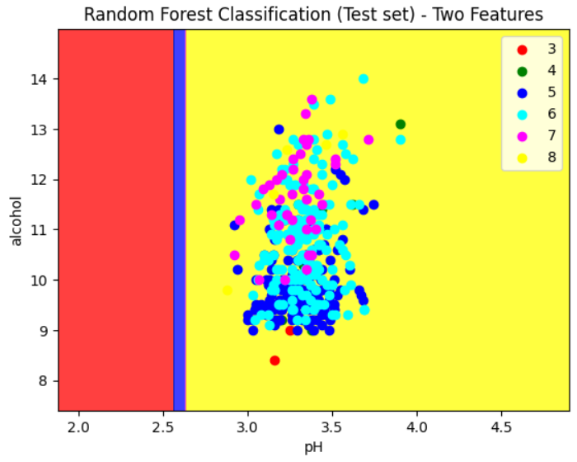
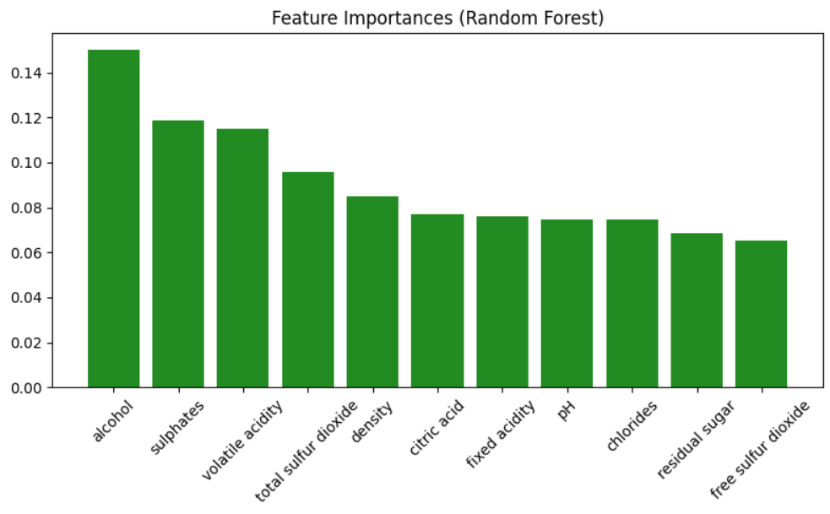
The Decision Tree Classification – Two Features
This graph shows the impact of the features on the quality.

Slide 11
THANK YOU

